Slide 1

Individual Service Strategy (ISS) – WIOA Youth (Part I)
WIOA TITLE I TRAINING VIDEO SERIES – march 2021
Notes:
Welcome to the WIOA Title I Training Video Series.

Slide 2
WIOA Title I Training Series
Clarifying Expectations and Key Takeaways
Individual Employment Plan
Measurable Skill Gains
Work Experience
Exit
Individual Service Strategies
Credential Attainment
Follow-up Services (Youth)
Notes:
This training series focuses on seven specific topics that are key to successful implementation of WIOA programs. This training focuses specifically on the development and use of Individual Service Strategies in youth programs.

Slide 3
ISS: A Roadmap for and of Youth Experience
An ISS provides the standards for assessment, development, and implementation of Individual Service Strategies for youth under the Workforce Innovation and Opportunity Act (WIOA) Youth Program.
Needs and Assets Assessment
Service Strategy Development
Service Strategy Implementation
Achievement of Outcomes
Notes:
An ISS serves as a roadmap for youth experiences in WIOA youth programs, offering the standards for assessment, development of a service strategy, documentation of that service strategy, as well as the achievement of outcomes

Slide 4
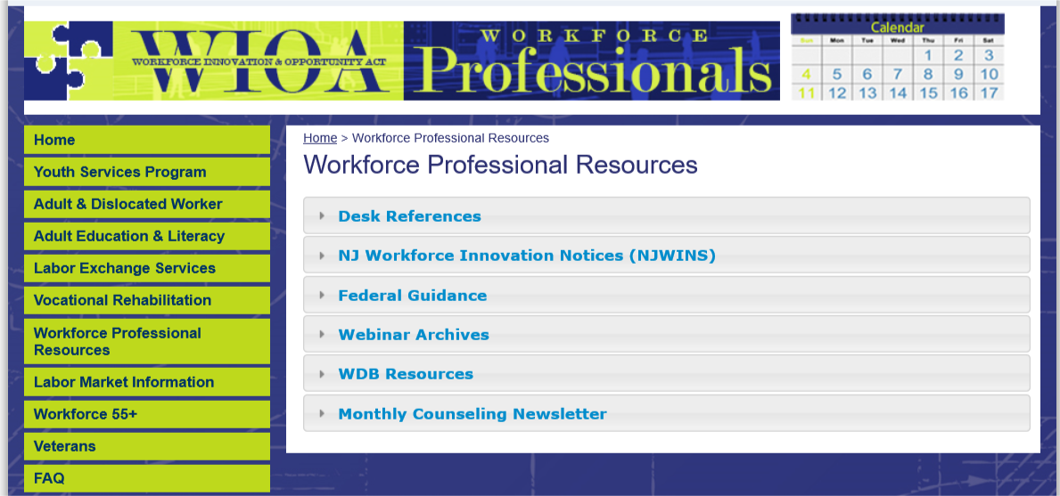
https://www.nj.gov/labor/wioa/resources/
Notes:
You can find New Jersey’s ISS policy in the Workforce Professional Resources section of the NJ WIOA website.

Slide 5
https://www.nj.gov/labor/wioa/resources/
Notes:
All policies that have been issued by NJDOL are available in the NJ Workforce Innovation Notices section.

Slide 6
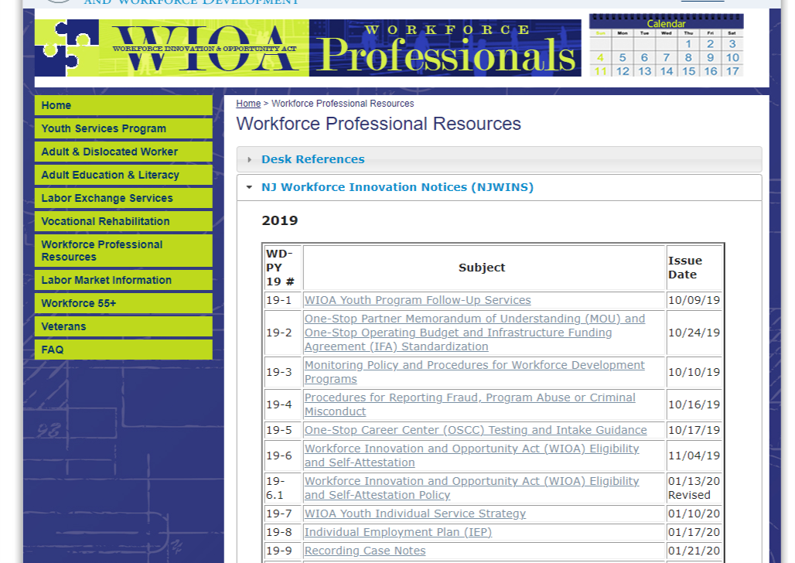
https://www.nj.gov/labor/wioa/resources/
Notes:
Including specifically the ISS policy, WD-PY19-7

Slide 7
Plan Components
Plan Development and Use
ISS Core Elements
Assessment of Need
Identification of Career Pathway
Connection to WIOA Performance Indicators
Planned and Actual WIOA Services
Referrals for Partner Services
Additional Requirements
ISS must reflect the unique needs of each participant
ISS must be signed by the youth worker and the participant
ISS must be reviewed at least every six months with the youth’s participation
ISS must be updated every time there is a significant event
Youth must actively participate in the development of the plan in their ISS
The ISS must be shared with all program providers.
Notes:
This policy highlights five core elements that should be part of an ISS – and are included in the state’s ISS Template. These include assessment of need, identification of career pathway, connection to WIOA performance indicators, planned and actual WIOA services, as well as referrals to partner services. In addition, this policy lays out specific expectations about plan development and use. We’ll spend the rest of this training video diving into more details around these core areas.

Slide 8
Assessment of Need
Academic Assessment
Must include a review of the youth’s basic skills.
Academic levels can be reviewed through previous assessments
For Out-of-school youth:
Must be assessed for basic skills utilizing a standardized assessment tool
Must crosswalk to educational functioning levels.
Occupational Skill Assessment
Assessment of skills includes review of:
Occupational skills
Prior work experience
Employability and interests and aptitudes.
Skill levels may be assessed utilizing:
Aptitude tests
Career/interest inventories.
Supportive Service Needs Assessment
Assessment of youth must include a review of the youth’s:
Supportive service needs
Developmental needs
Supportive services include:
Transportation
Child care
Dependent care
Needs-based payments
Other needs serving as a barrier to participation
Notes:
The development of an ISS starts with the assessment of a young person’s needs and interests. This assessment should include a review of academic skills, occupational skills, and supportive service needs. Academic assessments must includes a review of youth’s basic skills – usually through the CASAS test; if a youth has engaged in academic assessments recently, these can be used to assess academic levels. Occupational skills should include occupational skill assessments, reviews of prior work experience, employability assessments, and assessments of career interests and aptitudes. In addition, assessments should include a review of supportive service needs and developmental needs (including identification of accommodations for disabilities)

Slide 9
ISS Roadmap
Assessment of Need → Parts I, II, and IV of ISS
Notes:
These assessments of need tie specifically to the introduction and Parts I, II and IV of the state’s ISS template.

Slide 10
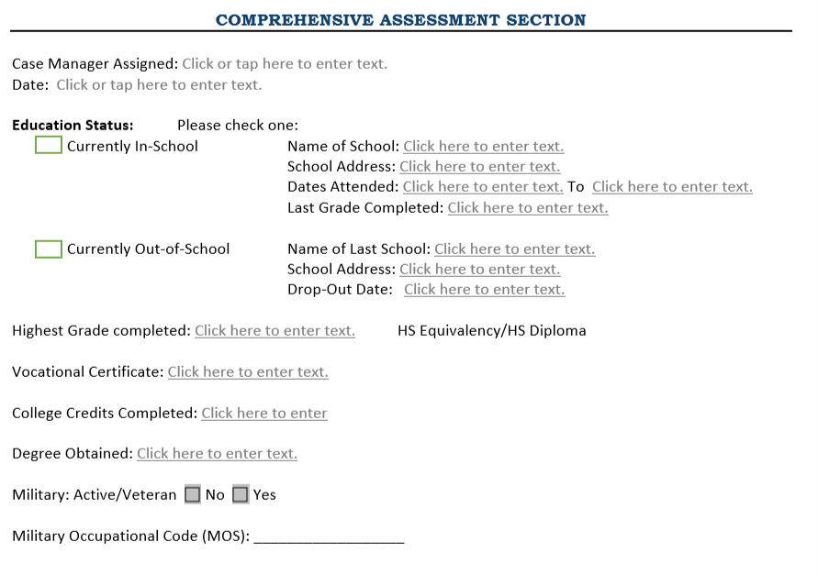
ISS Roadmap
Assessment of Need → Intro
Comprehensive Assessment Overview (page 1)
Education and Veterans Status
Notes:
On page 1 of the ISS is a Comprehensive Assessment for assessing education and veterans status.

Slide 11
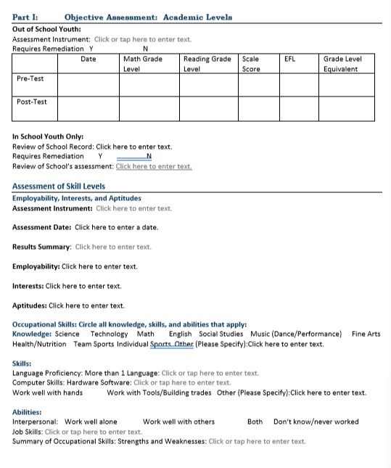
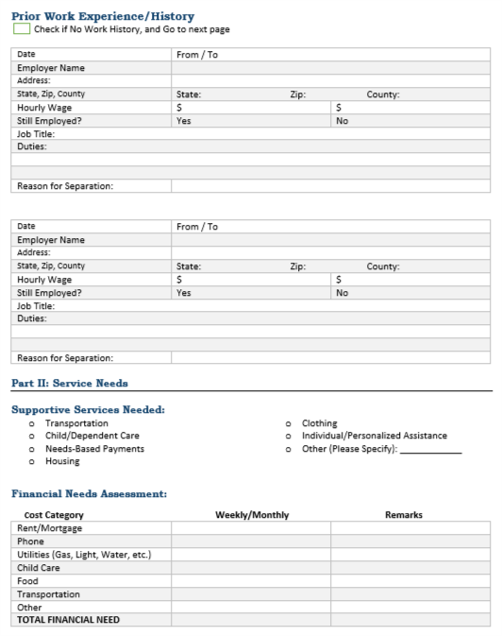
ISS Roadmap
Assessment of Need → Part I of ISS
Objective Assessment (pages 2-3)
Academic Levels
Assessment of Skill Levels
Prior Work Experience/History
Notes:
In Part I, on pages 2-3, the objective assessment includes an assessment of academic levels and occupational skills.

Slide 12
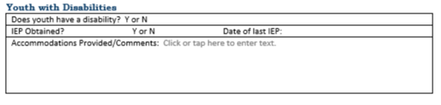
ISS Roadmap
Assessment of Need → Part II of ISS
Service Needs (pages 3-4)
Supportive Service Needs
Financial Needs Assessment
Youth with Disabilities
Notes:
In Part II, on pages 3-4, service needs includes an assessment of supportive service needs, financial needs, and disabilities assessment.

Slide 13
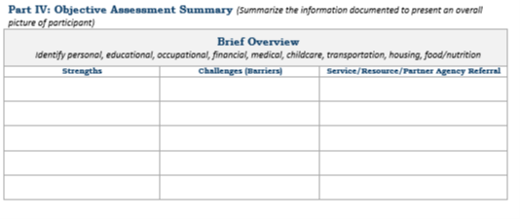
ISS Roadmap
Assessment of Need → Part IV of ISS
Objective Assessment Summary (page 4)
Strengths
Challenges/Barriers
Service/Resource/Partner Agency Referral
Notes:
In addition to recording individual assessment results, the ISS includes an objective assessment summary in Part IV on page 4 of the template for tying together and integrating assessment results.

Slide 14
Identification of Career Pathway
Career Pathway: The term ‘‘career pathway’’ means a combination of rigorous and high-quality education, training, and other services. A career pathway should include specific education and/or employment goals, and reflect the following:
In-Demand Occupation Alignment
Alignment with the skill needs of industries in the economy of the State or regional economy involved
Preparation for Pathway Success
Preparation to be successful in any of a full range of secondary or postsecondary education options
Counseling Support
Inclusion of counseling to support an individual in achieving the individual’s education and career goals
Integration of Education and Workforce Preparation
Inclusion of education offered concurrently with and in the same context as workforce preparation activities and training
Coordinated, Individualized Support
Organization of education, training, and other services to meet the particular needs of an individual in a manner that accelerates the educational and career advancement
Achievement of Education Outcomes
Opportunities for an individual to attain a secondary school diploma or equivalent, and at least 1 recognized postsecondary credential
Pathway Entrance/ Advancement
Opportunities for an individual to enter or advance within a specific occupation or occupational cluster
Notes:
The second key element of an ISS is the identification of a specific career pathway – a pathway that includes high-quality education, training, and other services connected to specific education and employment goals.
A career pathway should align with in-demand occupations in the state and your local region
It should include preparation that poises a young person for success along a full range of education options
It should include targeted counseling support
As well as both education and work-based learning opportunities
A career pathway should include a set of services that are individualized and coordinated
It must offer opportunities for meeting educational outcomes
As well as specific connection to entry into an occupation or occupational cluster

Slide 15
Connection to WIOA Performance Indicators
Measurable Skills Gain: Documented academic, technical, occupational, or other forms of progress, towards a recognized credential or employment
Education Placement: Participation and retention in education or training activities
Credential Attainment: Obtainment of a recognized postsecondary credential or a secondary school diploma, or its equivalent
Employment Placement
Participation and retention in unsubsidized employment
Notes:
An ISS should also include connection to specific WIOA performance indicators, including specific measurable skill gains, credential attainment, or education and/or employment placement

Slide 16
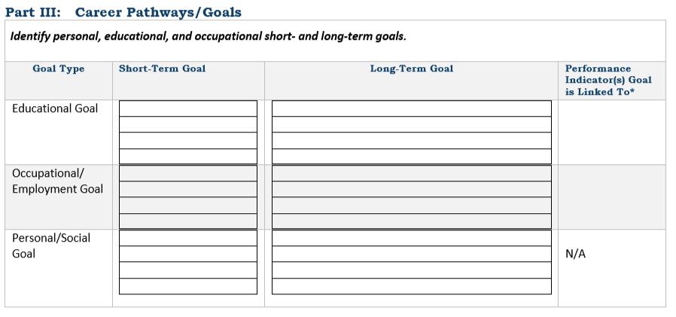
ISS Roadmap
Career Pathways and Performance Indicators→ Part III of ISS
Notes:
Career pathways and performance indicators tie specifically to Part III of the ISS.

Slide 17
Planned and Actual WIOA Services
Alt Secondary School
Work Experience
Occupational Skill Training
Tutoring
Education/ Workforce Prep
Leadership Develop- ment
Supportive Services
14 Program Elements
Guidance and Counseling
Adult Mentoring
Follow-up Services
Financial Literacy
Entre- preneurial Skills
Labor Market Information
Post- Secondary Prep
Notes:
The fourth critical component of the ISS is the identification and documentation of specific program elements that are part of a young person’s service strategy.

Slide 18
Planned and Actual WIOA Services
Alt Secondary School
Assessment results should inform program elements that will assist youth in achieving goals
All program elements should be available to each youth
Each youth must be provided the program elements that are determined appropriate for them
Each youth is expected to receive multiple program elements while enrolled in the WIOA youth program.
In addition, follow-up services should be offered and provided for at least 12 months following exit
Work Experience
Occupational Skill Training
Tutoring
Education/ Workforce Prep
Leadership Develop- ment
Supportive Services
14 Program Elements
Guidance and Counseling
Adult Mentoring
Follow-up Services
Financial Literacy
Entre- preneurial Skills
Labor Market Information
Post- Secondary Prep
Notes:
These program elements should tie explicitly to the results of assessments, and the career pathway and performance indicators that have been identified.
All program elements should be available to each youth
A youth’s ISS should include program elements that are appropriate for them based on identified needs and interests
While a youth’s service strategy does not need to include all 14 program elements, it should include multiple program elements.
In addition, follow-up services specifically should be offered and provided for at least 12 months following exit

Slide 19
Planned and Actual WIOA Services
Alt Secondary School
Assessment results should inform program elements that will assist youth in achieving goals
All program elements should be available to each youth
Each youth must be provided the program elements that are determined appropriate for them
Each youth is expected to receive multiple program elements while enrolled in the WIOA youth program.
In addition, follow-up services should be offered and provided for at least 12 months following exit
Work Experience
Occupational Skill Training
Tutoring
Education/ Workforce Prep
Funded program elements allowable in follow-up include:
Labor Market Information
Postsecondary Prep
Adult Mentoring
Financial Literacy
Supportive Services
Leadership Develop- ment
Supportive Services
14 Program Elements
Guidance and Counseling
Adult Mentoring
Follow-up Services
Financial Literacy
Entre- preneurial Skills
Labor Market Information
Post- Secondary Prep
Notes:
This includes the provision of specific funded program elements allowable in follow-up (including LMI, post-secondary prep, adult mentoring, financial literacy, and supportive services)

Slide 20
ISS Roadmap
Planned and Actual WIOA Services→ Parts VI and VII of ISS
Notes:
Information about specific program elements that are planned and in which youth actually engage are included in Part VI and VII of the ISS.

Slide 21
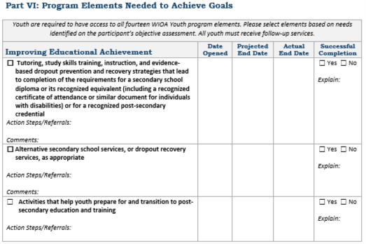
ISS Roadmap
Planned and Actual WIOA Services→ Part VI of ISS
Individual Program Elements (Pages 5-7)
  Intended Service
  Actual Service
  Successful Completion
  Action Steps/Referrals
  Comments
Notes:
Part VI highlights each of the program elements and offers space for documenting service start and end dates, indicating successful completion of the program elements, as well as action steps and comments.

Slide 22
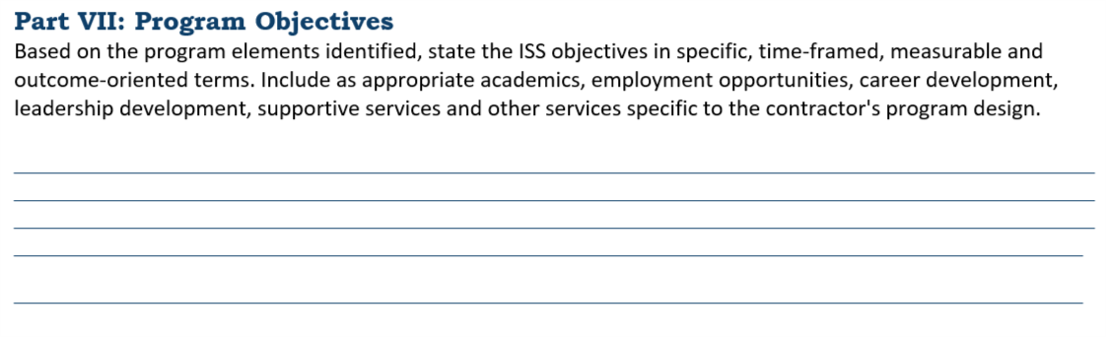
ISS Roadmap
Planned and Actual WIOA Services→ Parts VII of ISS
Overarching Program Objective (Page 7), inclusive of:
Academics
Employment
Career Development
Leadership Development
Supportive Services
Other Services
Notes:
Part VII of the ISS also includes the opportunity to highlight an overarching program objective of a young person’s service strategy.

Slide 23
Referrals for Partner Services
NJDOL does not require local programs to use WIOA youth funds for each of the program elements.
Local programs may leverage partner resources to provide some of the readily available program elements.
The local area must ensure that if a program element is not funded with WIOA Title I youth funds, the local program has an agreement (MOU) in place with a partner organization to ensure that the program element will be offered.
The Local Board must ensure that the program element is closely connected and coordinated with the WIOA youth program.
Notes:
Lastly, an ISS should also include referrals for partner services. A couple notes about referrals for partner services.
In some cases a young person may gain access to a program element through a referral rather than as a funded service. This allowed and encouraged.
A service strategy should leverage resources from other local programs who may be able to offer specific program elements without funding through WIOA.
In these cases, the local Workforce Development Board should have specific MOUs in place with partner organizations to ensure the program element will be offered.
Furthermore, the local board should ensure that program elements offered from different partners are still integrated with other services and ensure a connected and coordinated experience for a young person.

Slide 24
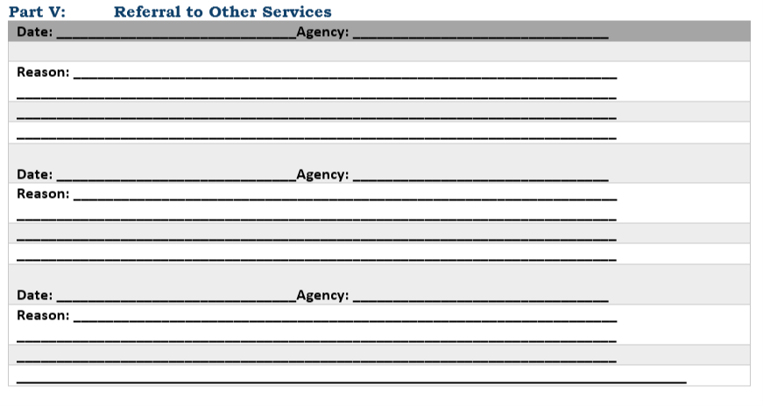
ISS Roadmap
Referrals to Partner Services→ Part V of ISS
Notes:
Referrals to Partner Services are documented in Part V of the ISS.

Slide 25
Plan Development and Use
ISS must reflect the unique needs of each participant
ISS must be signed by the youth worker and the participant
ISS must be reviewed at least every six months with the youth’s participation
ISS must be updated every time there is a significant event
Youth must actively participate in the development of the plan in their ISS
The ISS must be shared with all program providers.
Notes:
In addition to the components of the ISS, NJDOL’s policy also highlights specific guidance for development and use of the ISS.
An ISS must reflect the unique needs of each participant – they should be individualized based on the needs and interests of each young person
This ISS should be signed by the youth worker and participant.
Additionally, an ISS should be reviewed periodically, at least every 6 months, to revisit plans and also ensure ongoing documentation of services.
An ISS may also require updates because of changes or significant events in a youth’s life.
Critical to the development on an ISS is the active engagement of a young person in the development of their plan.
Additionally, an ISS should be shared with all program providers, it should be the basis for planning and documentation across all of the partners supporting and serving a young person.

Slide 26
Additional Resources
NJDOL Policy
NJ Workforce Innovation notices including WD-PY19-7 that outlines specific ISS policy can be found here:
https://www.nj.gov/labor/wioa/resources/
AOSOS Training Videos
Specific tutorials about entering Activities and Comments, the tabs in Customer Detail, and the tabs in Comp Assess can be found here: https://towork.dol.state.nj.us/aosostrainingmaterials/_layouts/15/start.aspx#/
Contact us at Career Services with any questions at WIOApolicy@dol.nj.gov
Notes:
This concludes our introduction to the ISS. The Part II training video for ISS provides specific details about how the ISS can be entered in AOSOS. Furthermore, additional resources including NJDOL’s policies and a series of training tutorials on AOSOS may help to augment knowledge of concepts highlighted in this training. If you don’t have access to these materials or have any additional questions, don’t hesitate to reach out to us at WIOApolicy@dol.nj.gov

